Slide 2
Jumping the Canyon
From Strategic to Business Partner…….…. and beyond

Slide 3
What does it take?
Nature – The “DNA”
Nurture – The Environment
Why the “H”s in HR do what they do
Teacher (s) – Mentors who will guide you
Fire – Courage, Passion or Both
Arable Land - Receptive Culture
A Brass Ring – a possible ROI
Leadership - Willingness to Delegate
Credibility – Knowledge of real Business issues
Sales Skills – Listen, Learn, Present, Close & Act

Slide 4
The HR Trap
So much of our time is spent
supporting the initiatives of
others, that we forget our own
agenda.
Our work is so “outward” focused
that it precludes us from seeing,
and planning for, ourselves.

Slide 5
Where, when and how we are raised
Informs and influences everything we
Do and become.
When we were born.
Our family life.
Our means and access to resources
Our commitment to effort.
Emotional States and their Effects on the Decision Making Process

Slide 6
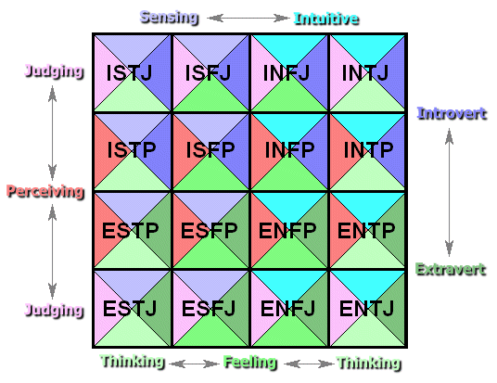
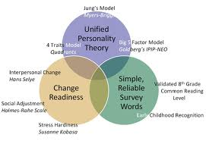
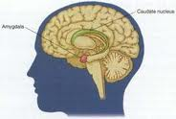

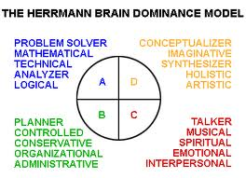
What Makes You Tick?
Myers Briggs Analysis
Five Factor Model

Slide 7

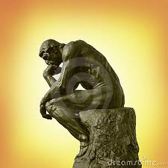


Understanding “H” s -
Why we do what we do.

Slide 8

Daniel Ariely
Who he is and why we might care what he says.

Slide 9
The Trust Game
$10
$0
$0
Mr. A
$25
$10
?
?
Revenge
$25
Mr. B
$10
$50
?
$50
$10
Notes:
People want to do right…and punish those who don’t

Slide 10
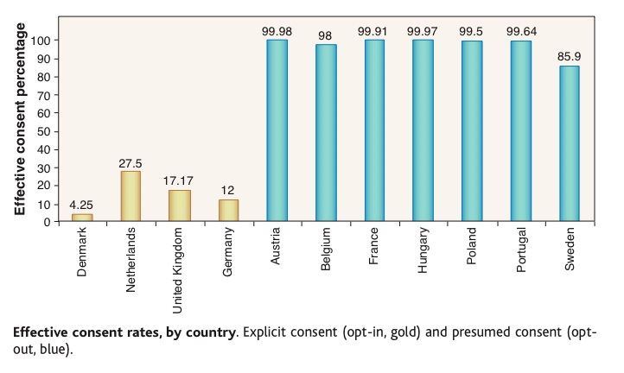
The Mystery Influence
If people are essentially altruistic…why are these results so skewed?
Notes:
When things are complicated…the tendency is to do nothing

Slide 11


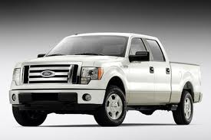



Happiness & Satisfaction
They are
relative
to what
others
Have or
can get.
Notes:
How we feel and act is based on relativity

Slide 12

Stumbling on Happiness
We’re the only ones up in our head so everything is unique and special…but it isn’t.
We are alike. The best way to know what something will be like is to ask someone who’s already there or doing it.
Notes:
Everyone thinks they’re special…we aren’t any different than anyone else…go ask what it’s like

Slide 13
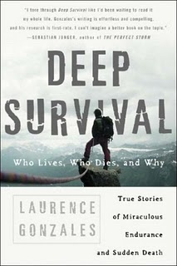
Deep Survival
Why this book was written
Kayakers
Scuba Divers
Pilots
Mountain Climbers
Notes:
Experience is often just familiarity not always superiority

Slide 14
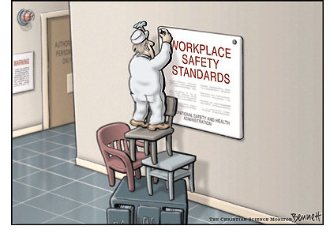
Experience is often making the same mistake over and over without experiencing the consequence

Slide 15

“18 seconds into the patient’s description of symptoms, the doctor is no longer listening.”

Slide 16

Freakonomics
Why the waiter is ignoring you…
If people don’t behave as you’d hoped; and or the results aren’t what you’d intended then the incentives are wrong or misaligned.

Slide 17
What we know so far…
We want to be part of society and help
We will be vindictive if wronged.
If it’s complicated…we’re prone not to act.
How we feel about something is relative.
Experience is often several errors without penalty. (1st 6 mos.)
We solve problems the way we always have, unless someone gets us to “jump our rut”
If we’re not acting as hoped…there’s probably a good reason

Slide 18





The Value of a Mentor
Choate
Mentor
Bob Ehret
Robino
Waldron
Perkins
Renfro

Slide 19
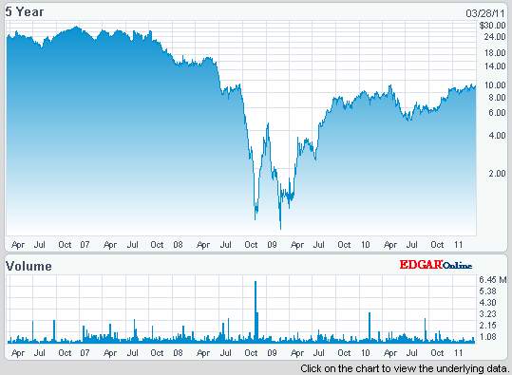

ABD
$9.24 0.13 1.43% 66,257 Shares Traded
SEE PRICE HISTORY Update Quotes:On
The Turn Around
Danger
Of being
De-listed

Slide 20
How they did it…
Change of Leadership
Complete Transparency Internally
In Depth Interview of the Customer
Unified commitment to Change driven
from the top.
The 5 Dysfunctions of a Team
Shared pain across all levels

Slide 21
ARABLE LAND…
  ACCENTURE STUDY
    Revealed widespread executive dissatisfaction with HR’s strategic contribution

Slide 22
ARABLE LAND…
  MERCER DATA
    Only 9% of CFOs view HR departments as primarily strategic
Notes:
A Mercer survey found that only 9% of CFOs view their HR departments as primarily strategic, and a 2003 Accenture study revealed widespread executive dissatisfaction with HR’s strategic contribution.
What exactly are these C-level executives looking for from a reinvented, strategic HR department? What can you do to rise to C-level expectations? Here’s what the research indicates that forward-looking HR departments need to do.
According to research published in the AMA’s Management Review, these executives place a very high value on information like employee performance data—yet a mere 16% trust the numbers HR comes up with
22

Slide 23
ARABLE LAND…
  AMA RESEARCH REVIEW
    Executive need metrics (i.e. performance data), but only 16% trust HR to deliver

Slide 24
Arable Land…
The Corporate “Horror”scope
3 rules of the “Closely Held” Co.
The “Cadillac of Coaching”
You can move to Alaska…but you cannot grow fur.

Slide 25
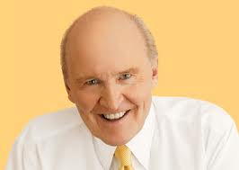
Jack Welch on HR

Slide 26
JACK WELCH ON HR
“Look, HR should be every company’s “killer app.” What could possibly be more important than who gets hired, developed, promoted, or moved out the door?
Business is a game…the team that puts the best people on the field and gets them playing together wins. It’s that simple.”
Notes:
You would never know it, though, to look at the companies today where the CFO reigns supreme and HR is relegated to the background. It just doesn’t make sense. If you owned the Boston Red Sox, for instance, would you hang around with the team accountant or the director of player personnel? Sure, the accountant can tell you the financials. But the director of player personnel knows what it takes to win: how good each player is and where to find strong recruits to fill talent gaps.”
HR should be #2 function in company. Often it is 5th, 6th, or even worse.
*Houston Texans – who do you think McNair spends more time w/ -- Team Accountant or VP of Player Personnel? Bobby Grier - Associate Director of Pro Personnel
26

Slide 27
JACK WELCH ON HR
"If there was ever a time to underscore the importance of HR, it has arrived…
HR matters enormously in the good times. It defines you in the bad."

Slide 28

The Brass Ring
Kim Bors – Former SVP HR
Dennis Christiansen – Former CEO
Consolidation of 40+ disparate
Healthcare plans gave Idex a
$4 million boost in one year.
CREDIBILITY

Slide 29






Leadership
Mentor#
Larry Pilon

Slide 30
Larry Pilon
“Larry has a great eye for talent.
He doesn’t mind any new mistakes
And expects his people to come to
Him with both the problem and the
Solution.
No one ‘blocks’ better. He is great
At running interference with the
Executive group so you can do you
job”
- Sandi Stevens

Slide 31
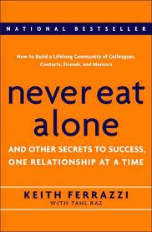
Selling Your Value
What are your company’s needs…not wants?
How do your “customers” get their work done?
What ROI can you provide to your customers?
15 second question
2 minute explanation
10 minute presentation
Get the commitment
ACT!
Delegate, Manage, Inform and Report

Slide 32




Brand
Perception of a product reinforced by it’s use.

Slide 33
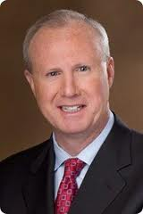



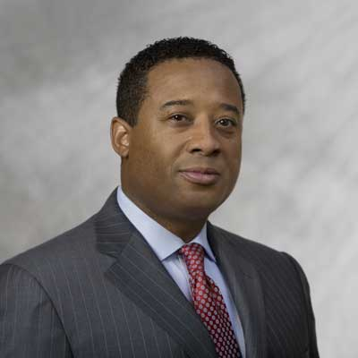
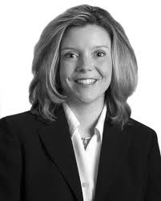
What is the perception of your product, i.e. HR?
HP
McDonald’s
Apple
Monsanto
Caterpillar

Slide 34


Brand Loyalty
VS
the positive resolution
of problems

Slide 35
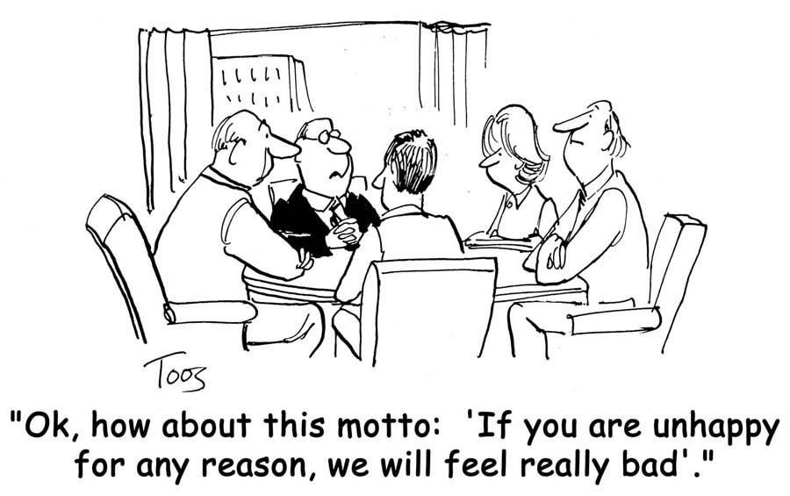
How do you positively resolve HR problems?

Slide 36
Q & A

